Slide 1


BEACH HACK 5:2022
KUNI
1.Ashish Gangwar 2.Anjali Bhardwaj 3.Ashif Alam 4.DeV Khetan

Slide 2


Problem Statement
At the present time, Seashores are major tourist attractions. But cleanliness in our seashore are very low
Suggest a mechanism to ensure pollution free seashores.
Polluted beach water makes swimmers sick and hurts coastal economies.
Illnesses associated with polluted beach water include stomach flu, skin rashes, pinkeye, respiratory infections, meningitis, and hepatitis.

Slide 3

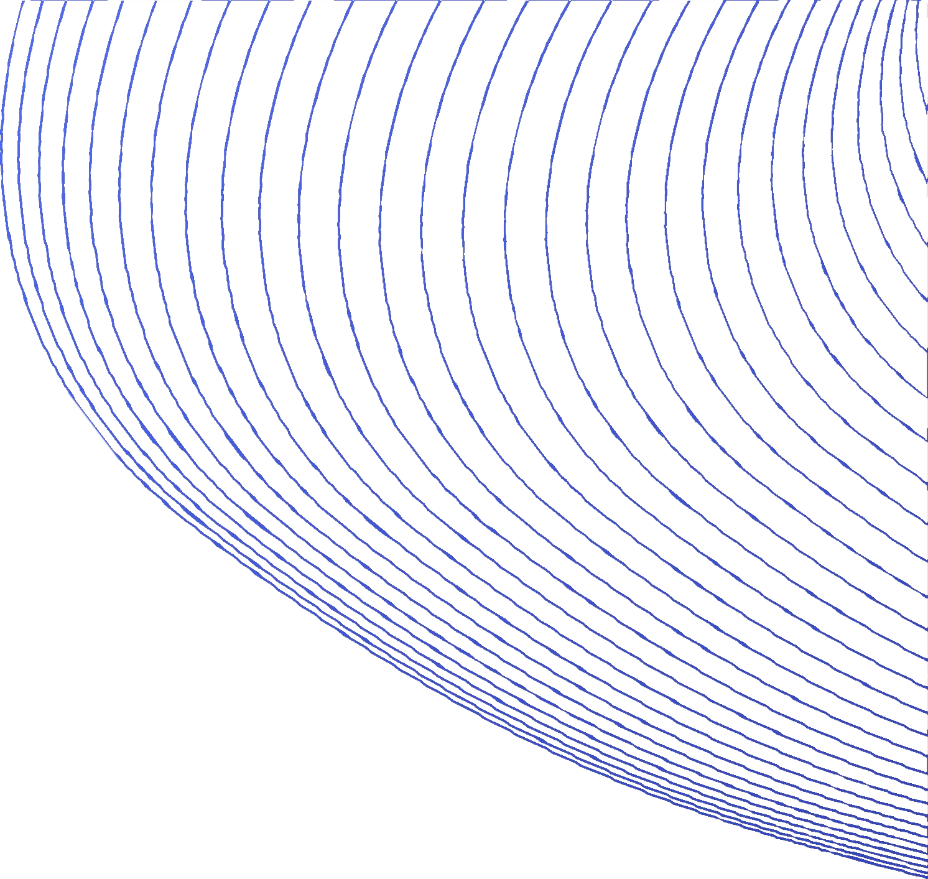



SOLUTION
we have created a website where we are working with the municipal corporation to help them clean our beaches effectively and efficiently.
Also we will be focusing on encouraging people to help us clean the beaches .

Slide 4
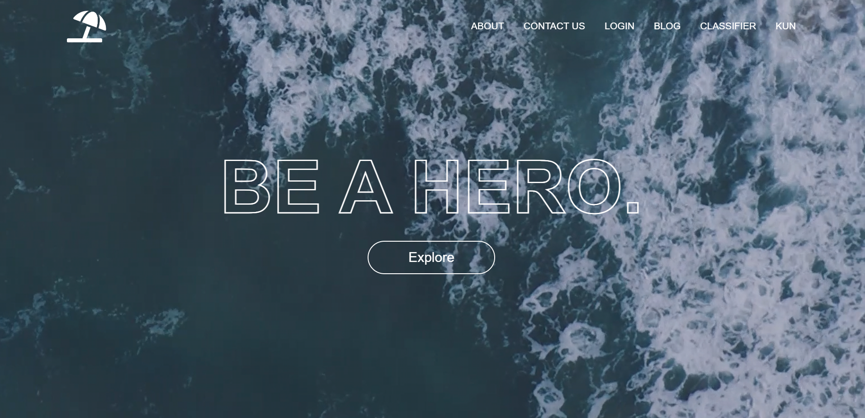

Slide 5
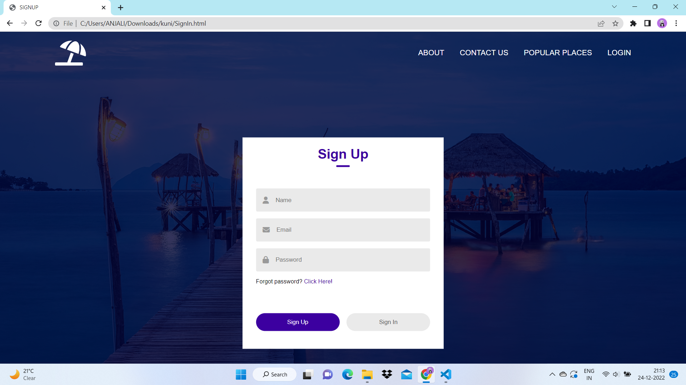

Slide 6

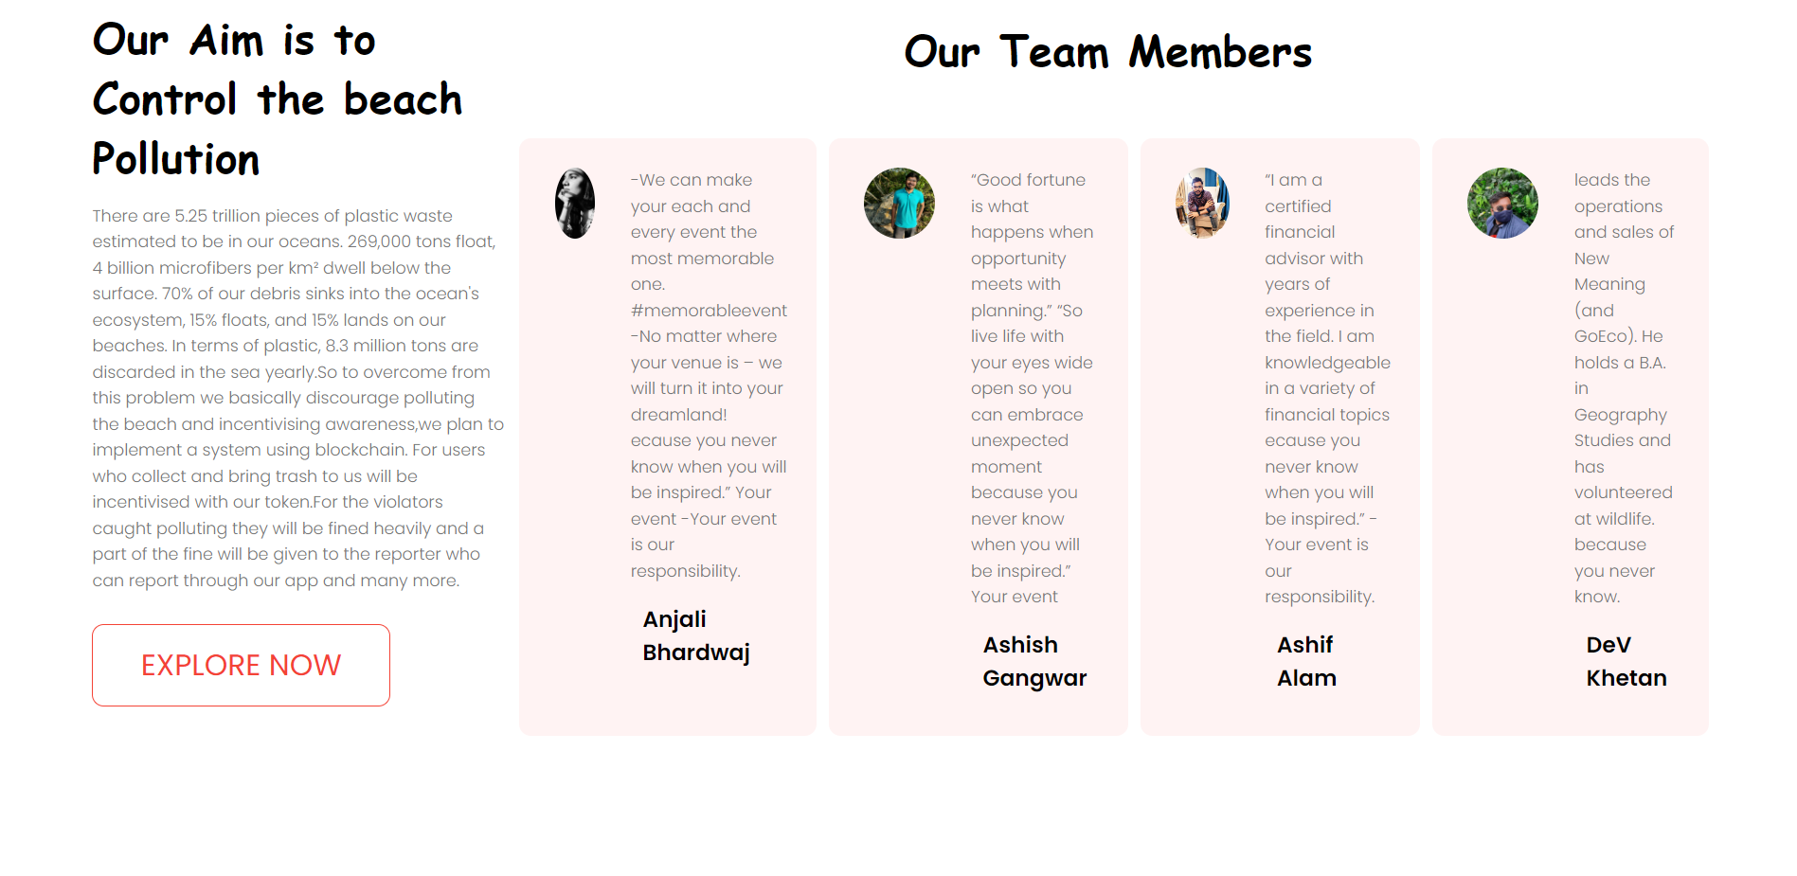

Slide 7
1. Modern problems require modern solutions:-
To discourage polluting the beach and incentivising awareness , we have made our own cryptocurrency KUN using Binance Smart Chain
we plan to organise events and competitions regularly where common people will come and join our hands in cleaning the beach.
beach cleaning days will be organised where volunteers can come and help us and top volunteers will be gifted some amount of our crypto tokens

Slide 8
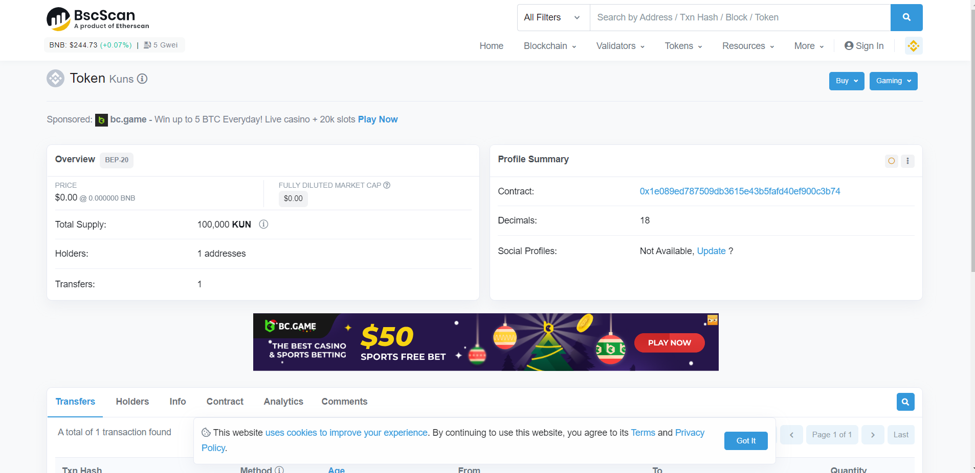

Slide 9

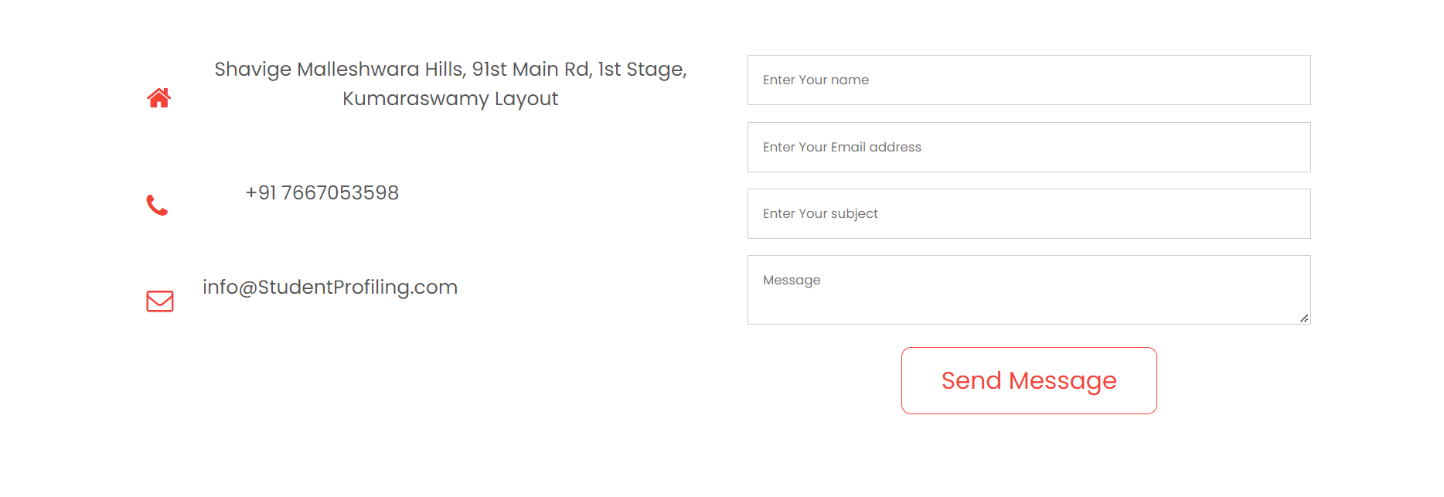

Slide 10

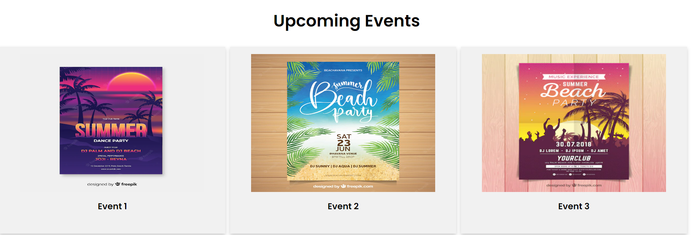

Slide 11
The reason why we created our own token is that , inititally we dont have funds to give away but by giving our token we are making people a part of our
community whose growth will lead to the growth of
out token too.
Some people will be hired to impose heavy fines if we find someone guilty of polluting our beach.
The fine would be 250/-approx.
people paying fine will get a discount if they choose to pay with our token , we are doing as to increase demand of our token resulting in higher value

Slide 12




2a. Time series analysis
predicting amount of waste that would be generated using the previous data.
This will help in knowing which day in a week the waste generated would be maximum and accordingly we can send our workers to clean it.

Slide 13
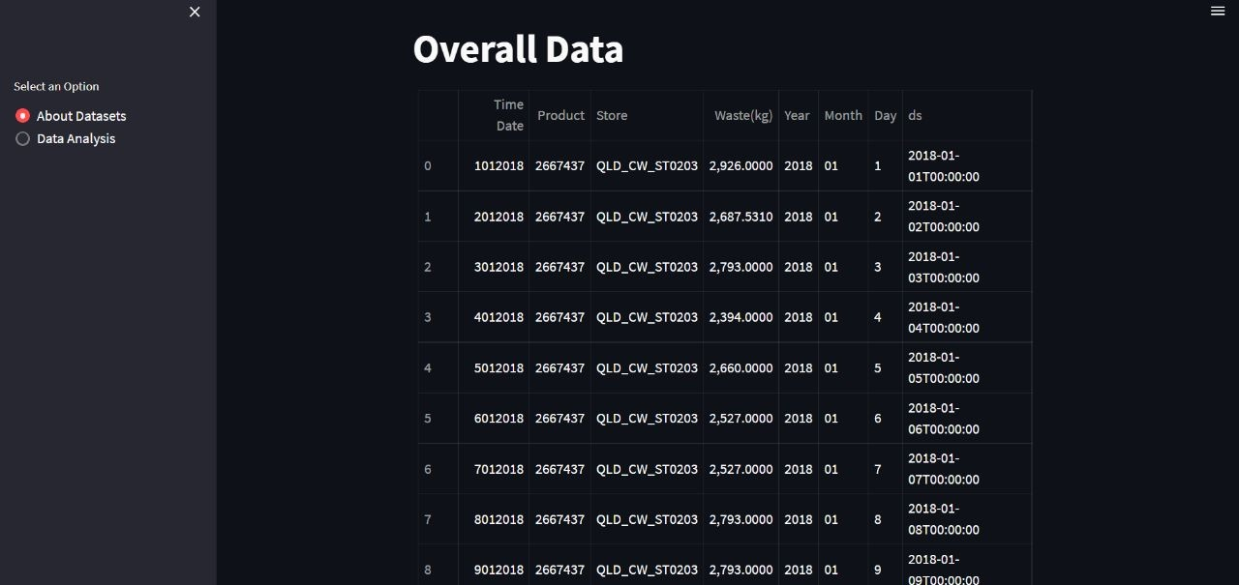

Slide 14
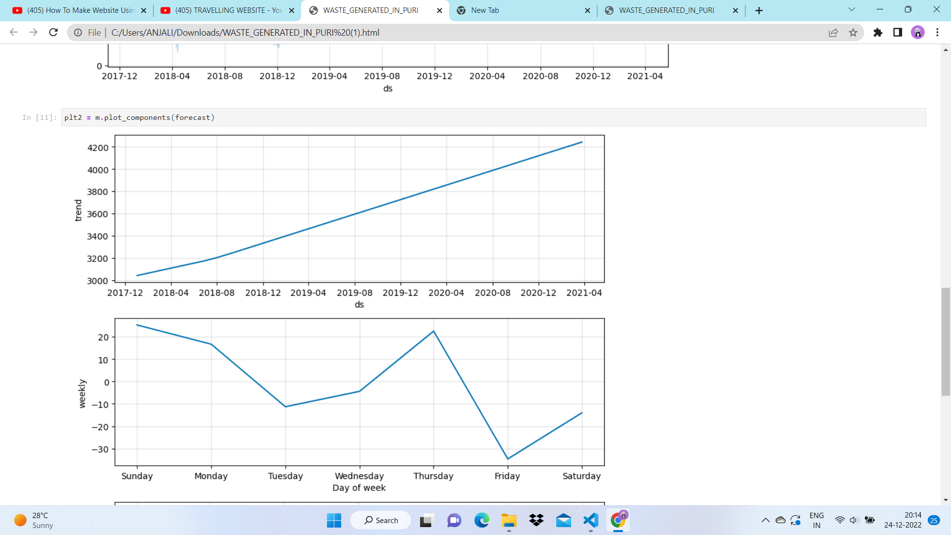

Slide 15
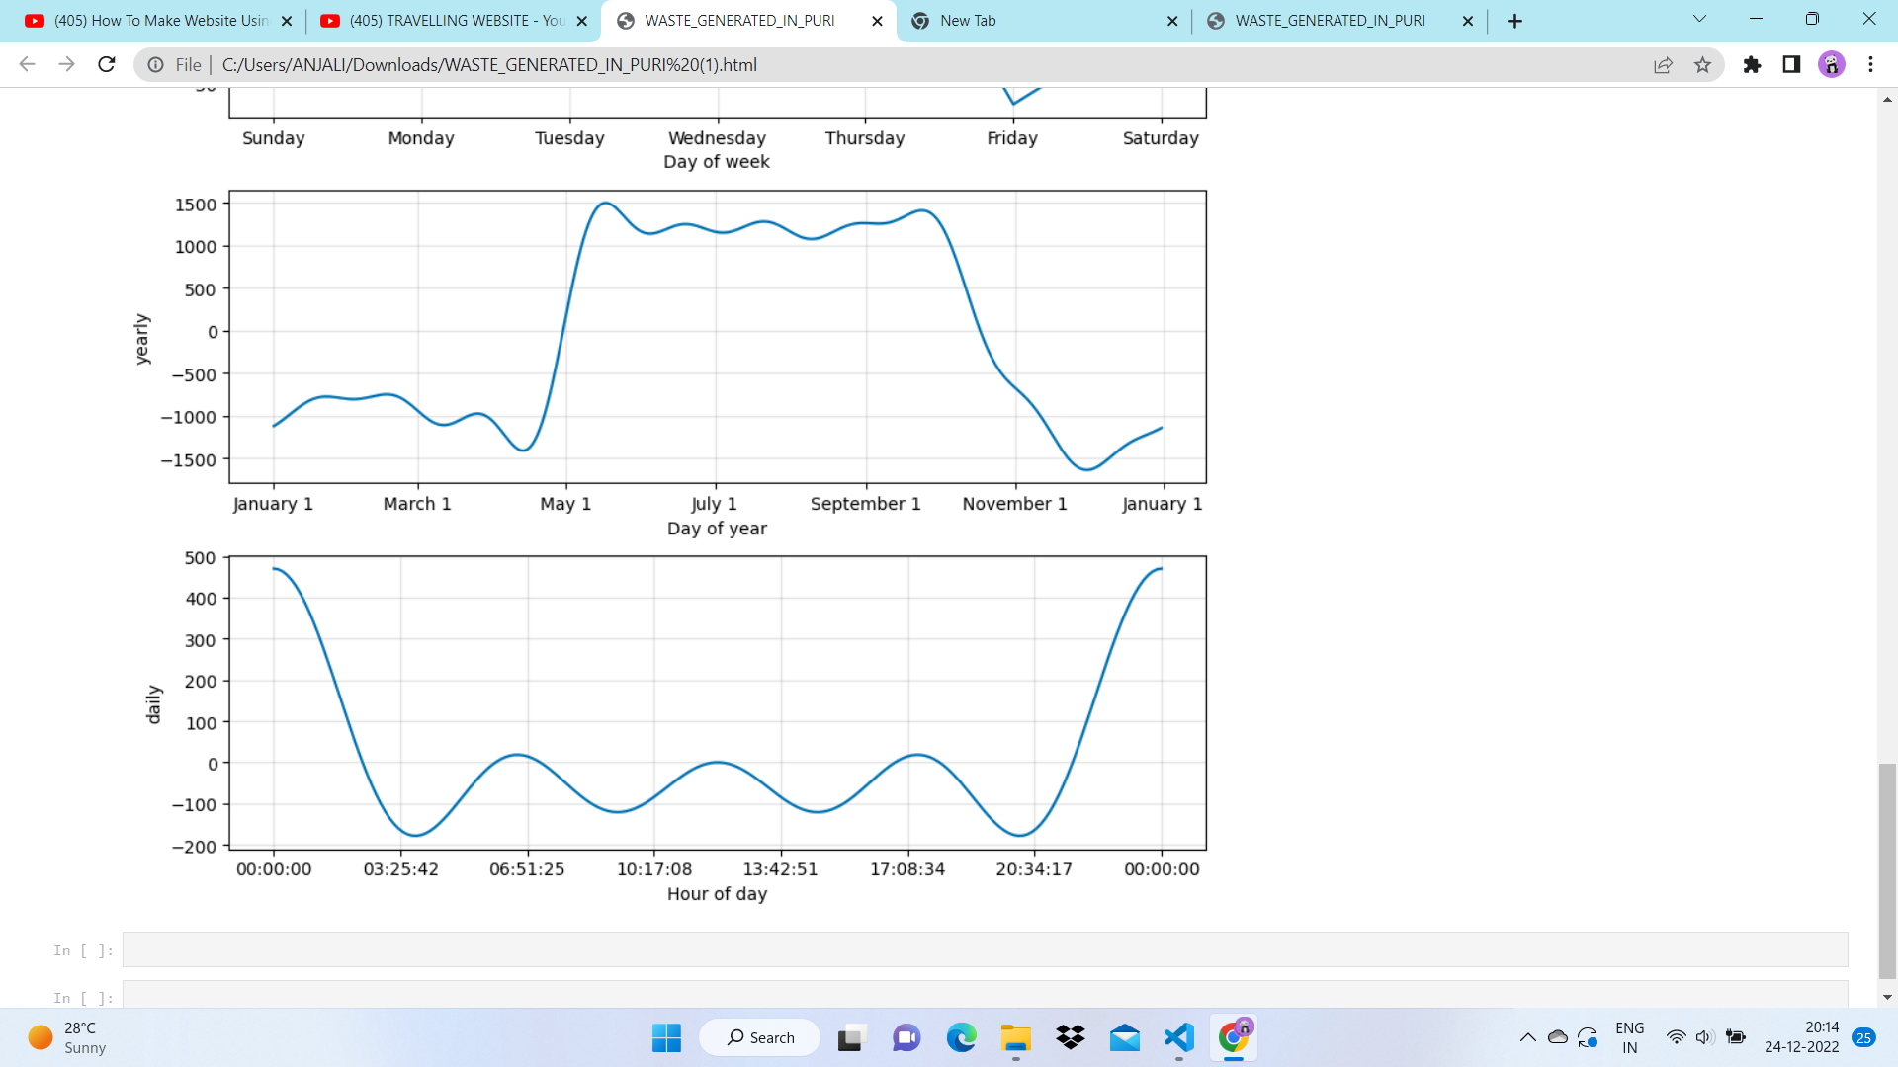

Slide 16
2b. Time series analysis
second use of time series analysis is to predict when the crowd on the beach would be minimum at a particular time in a beach so we can send
workers at that particular time to clean the beach efficiently.

Slide 17
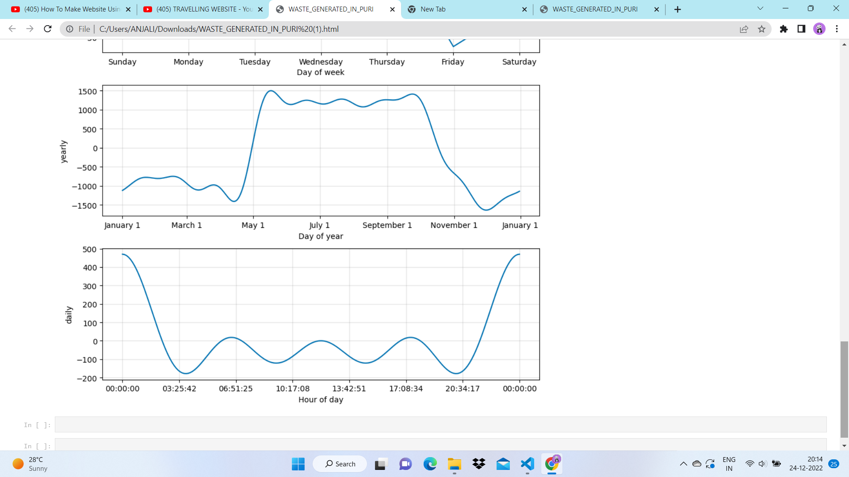

Slide 18
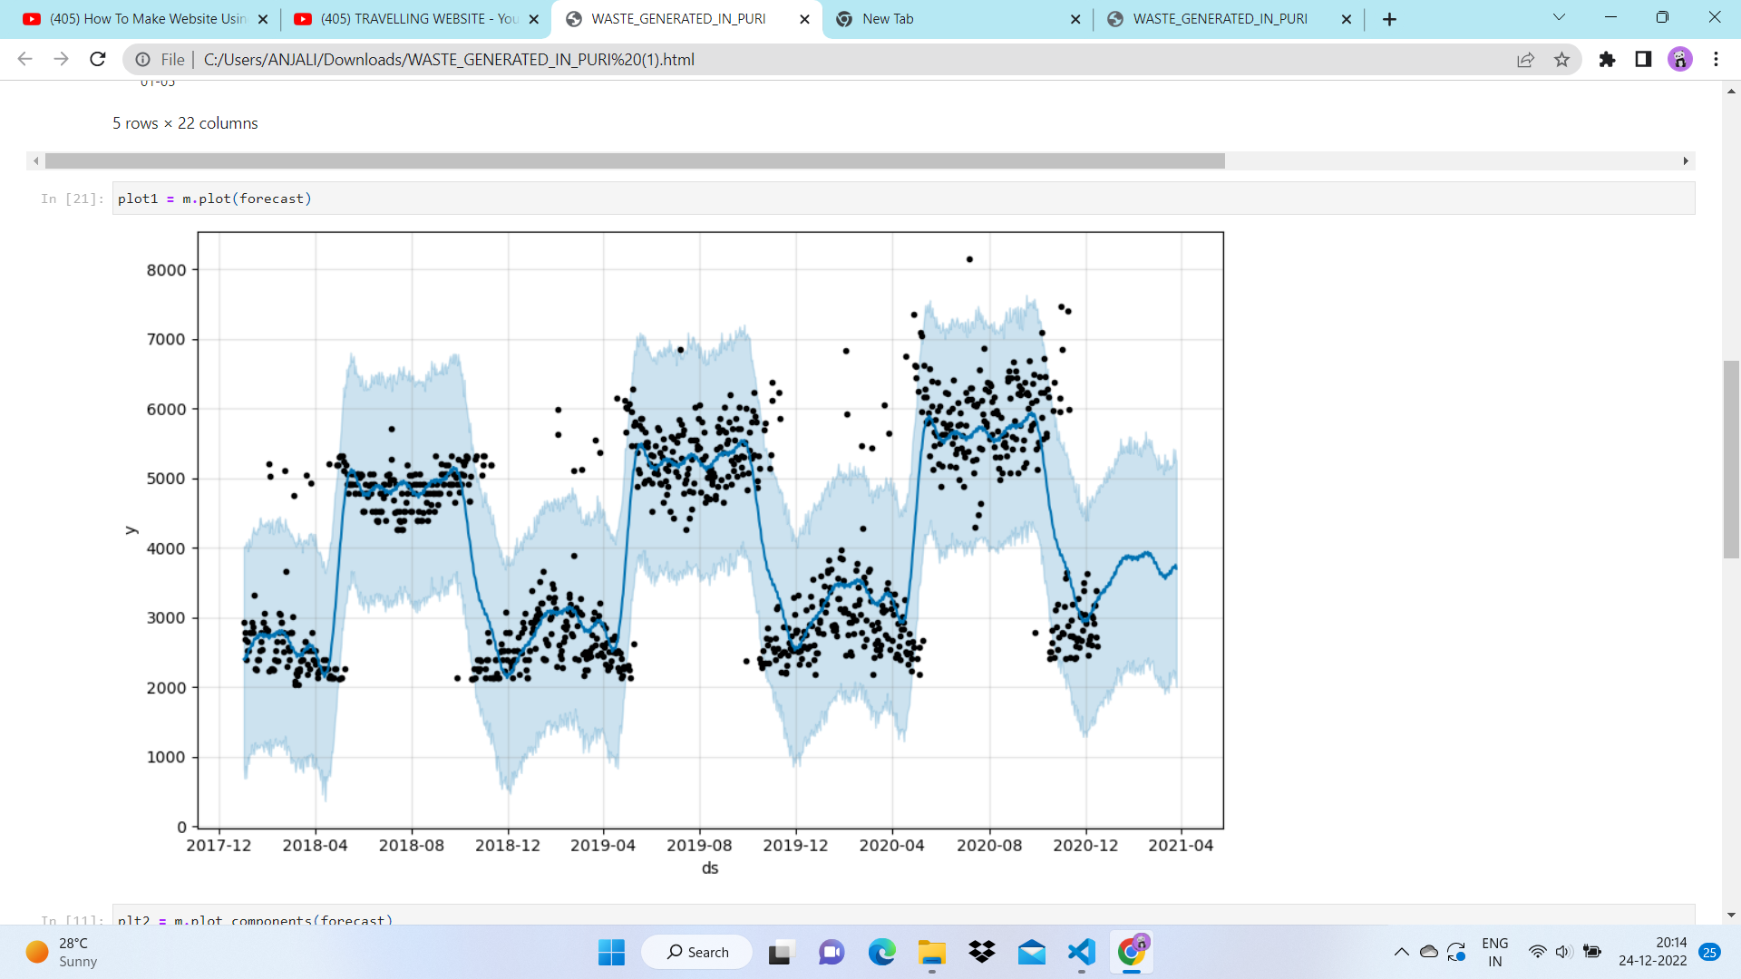

Slide 19
3. Image classifier
Image classifer helps in segregation of waste,because of which all the organic waste and recyclable waste that is collected can be suplied to companies and we will ask them to buy it using our cryptocurrency so that our token value will also be increased.
All the hazardous waste would be given to municipal.

Slide 20
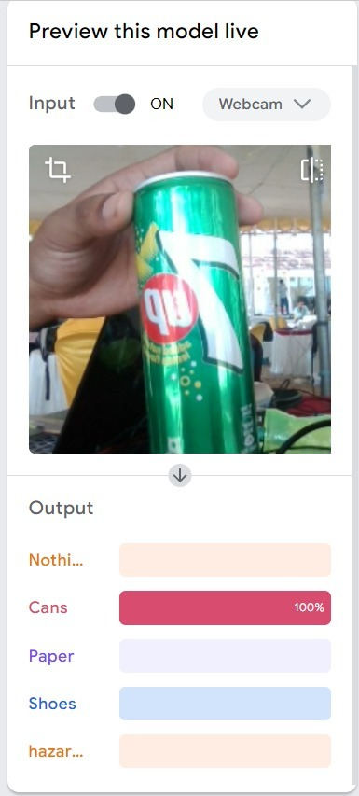
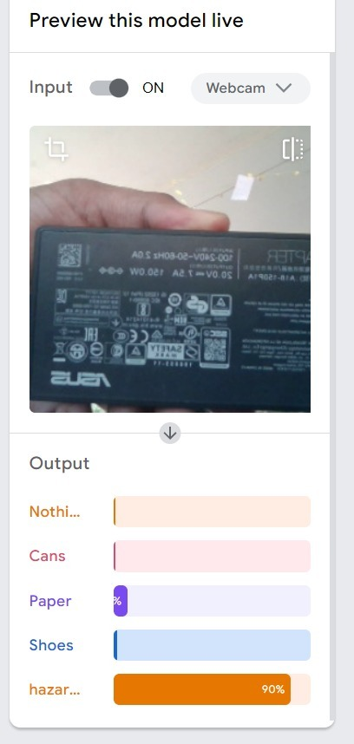

Slide 21
according to The Hindu,on an average on a urban beach 71% is plastic 28%non plastic and 1% biomedical
Almost 62 million tonnes of waste is collected with annual growth of 4% and currently out of it only 20% is recycled rest ends in land fill
It is estimated that waste management in india is 15 billion us dollar industry
main source of revenue will be from industry and imposing fine on people polluting the beach.

Slide 22
Future plans
we also tried to implement object density model where it could be helpful to indicate the density of waste at a any particular case but we removed it for now due to overhead cost,but we definetly come up with a solution for this as technology advances

Slide 23
Thank you

